Slide 1

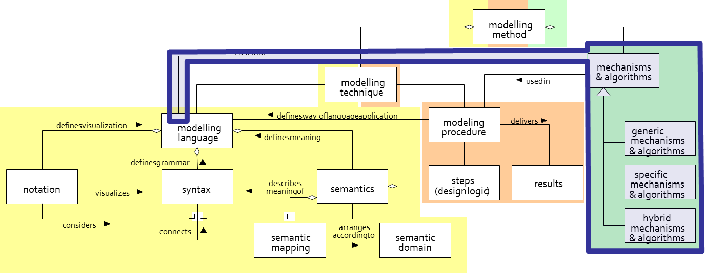
SCENARIO:
Implementing an Algorithm
ADOxx Tutorial
Parsing and Comparing Models with AdoScript

Slide 2
Scenario Description
Case:
To compare given two versions of the same model.
GOAL:
To implement an algorithm that parses a model (tree-traversal) and compare it with the second version.

Slide 3
Agenda
DOM tree
Tree Traversal
    Breadth-first
    Depth-first
    Monte Carlo tree search
Tree Traversal with ADOxx
Model Parsing and Comparison
    Object Level
    Attribute Level
Visualization of the Results

Slide 4
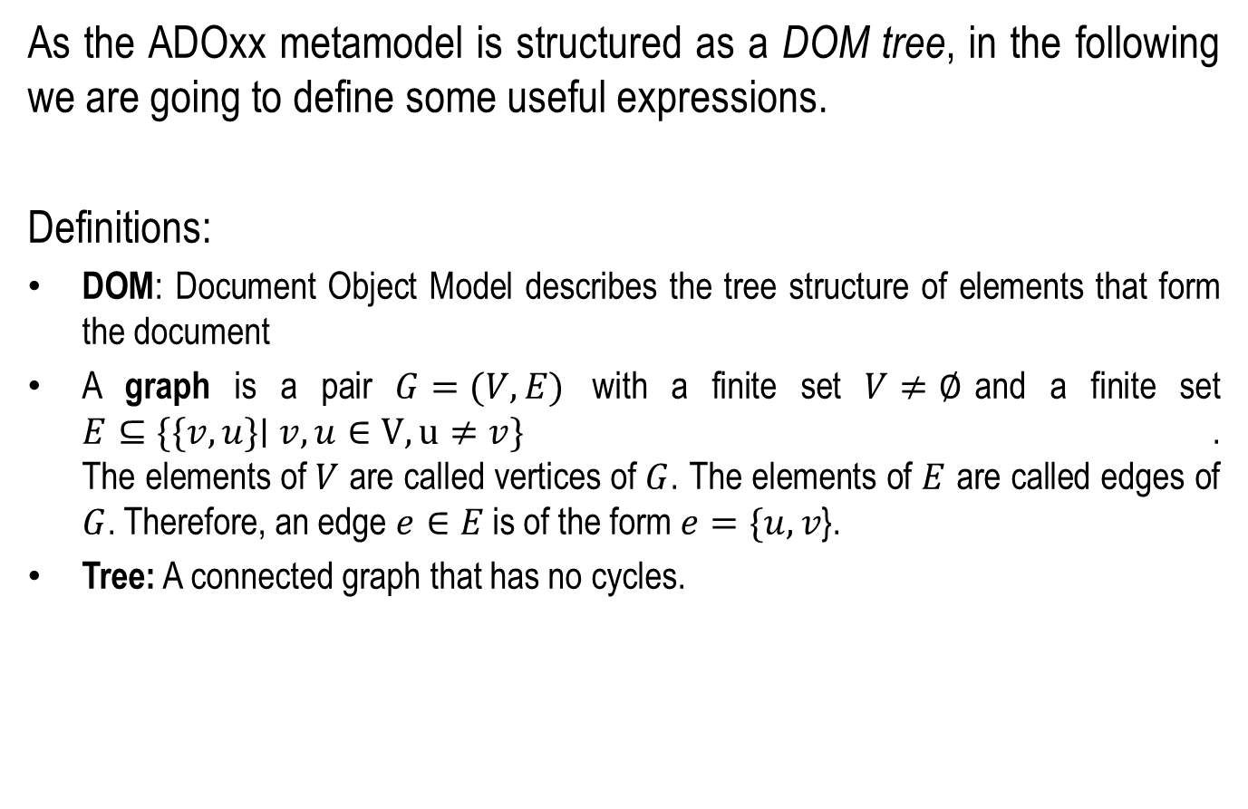
DOM-Tree
As the ADOxx metamodel is structured as a DOM tree, in the following we are going to define some useful expressions.
Definitions:
DOM: Document Object Model describes the tree structure of elements that form the document
A graph is a pair $G=(V,E)$ with a finite set $V≠∅$and a finite set
$E⊆\{\{v,u\}\text{∣} v,u∈V, u≠v\}$.
The elements of $V$ are called vertices of $G$. The elements of $E$ are called edges of $G$. Therefore, an edge $e∈E$ is of the form $e=\{u,v$}.
Tree: A connected graph that has no cycles.
Notes:
4

Slide 5
ADOxx DOM-Tree Levels
Application Library
Model Types: A model type is a well-defined sub collection of classes and relation classes of a meta model.
Classes: A class is a construct that is used as a template to create objects of that class. The objects of a class are alternatively called "instances“
Attributes: An attribute is a property of a modelling construct such as a model, object or relation. Each attribute has a type and a value.
Model Type
Contains the definition of
Is the base of
Model
Contains
Class
has
Instances to
Object
Attribute

Slide 6
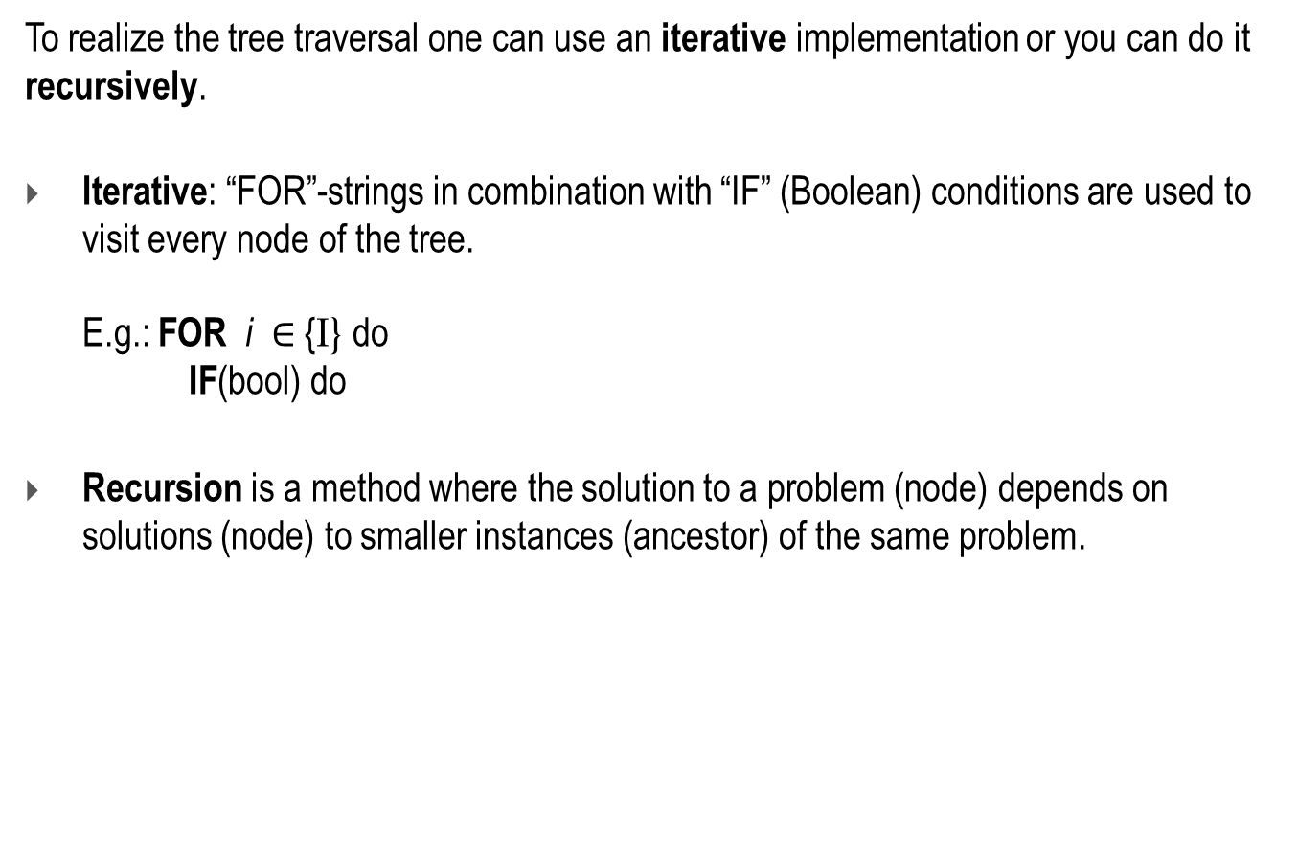
Tree Traversal
To realize the tree traversal one can use an iterative implementation or you can do it recursively.
Iterative: “FOR”-strings in combination with “IF” (Boolean) conditions are used to visit every node of the tree.
E.g.: FOR i $∈$ {I} do
IF(bool) do
Recursion is a method where the solution to a problem (node) depends on solutions (node) to smaller instances (ancestor) of the same problem.

Slide 7
Tree Traversal
To parse and analyze trees there are tree traversal algorithms. This algorithms are divided into three groups.
  Breadth-first
  searches along the branches into the depth. There are three ways to doing this:
    Pre-Order
    In-Order
    Post-Order
  Depth-first
  searches level after level. That means that every node of a level is visited before going to the next level
  Monte Carlo tree search
  concentrates on analyzing the most promising moves, basing the expansion of the search tree on random sampling of the search space

Slide 8
Tree Traversal with ADOxx
Model parse with AdoScript
Export Model as XML and parse with JAVA
  DOM Parser
  SAX Parser
  JAXB
Export Model as XML, do XSL transformation to a different file-type (e.g. RDF), and parse.

Slide 9
Iterative Tree Traversal and Comparison with AdoScript
In the following you will get an introduction how to parse a model iteratively using AdoScript and compare it with another one.
See below the tree structure of a model in ADOxx.
M
A
Attr2
B2
Attr1
Attr2
B1
Attr1
B
Attr2
Attr2
A1
Attr1
A2
Attr1
Model
Class
Objects
Attributes
Figure: Model Hierarchy

Slide 10
Pseudo Code: Iterative Breadth-first Model Parsing
SELECT Model
GET all visible Classes
FOR each class: GET all objects
FOR all objects: GET all Attributes
FOR all Attributes: -GET attribute value
-GET attribute type

Slide 11
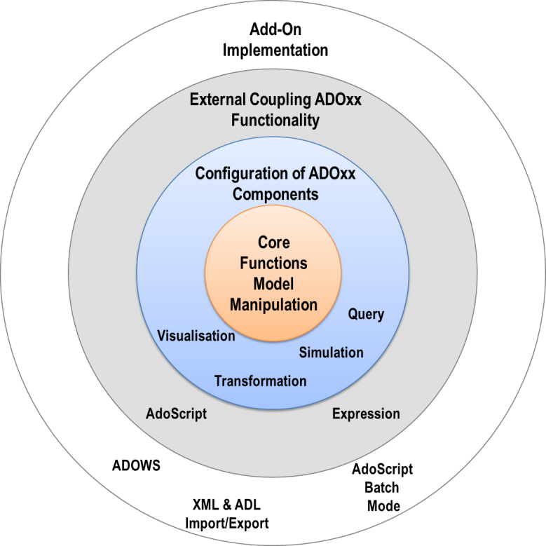
ADOxx Functionality on Meta Level

Slide 12



Iterative Tree Traversal and Comparison with AdoScript
Description of the Algorithm
Model A
Model B
FOR each object get all attribute values
GET All Classes
AQL Expression:
({"A1“}[?"String" = "xx"])
FOR all Classes Get all objects
AQL Expression: <“Object_Name”>
Save in the Notebook
Save in the Notebook
Query the objects
in Model B
[IF $∄$]
[IF $∃]$
Query the values in
the corresponding
object attribute
[IF val1$≠$val2]

Slide 13



ADOxx Realisation Approach
ADOxx:
Menubar
User-Interface
ADOScript:
Compare Models
ADOScript:
Core
ADOScript:
AQL
Database
Trigger
Select 2 Models
Get Selected (A, B)
Get visible classes of Model A
Get all objects for each class
Query each object in model B
Save
[IF $∄$]
[IF $∃]$
Get all attributes
for each object
Get attribute values for each attribute in A
[IF output =$∅$]
Query every value with the corresponding attribute in B
Save

Slide 14
Mapping ADOxx Functionality
User-Interface
AdoScript
Compare models
Database
ADOxx:
Menubar
ADOxx:
Notebook
AdoScript:
Core
AdoScript:
AQL
AdoScript:
Core
ADOxx:
Database

Slide 15

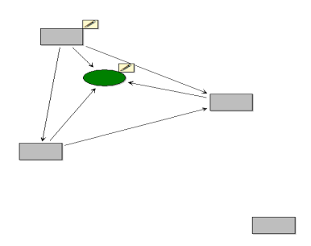
Meta Modelling Layer: Implementing and Algorithm
Component:
AQL, Modeling
ADOxx
Meta2 Model
provides
developed
in
C++, C#, Java
Specialisation of
Instance of
CC "CoreUI" MODEL_SELECT_BOX title:"Select Modified Model"
SETG id_NewModelId:(VAL modelids)
SETG str_endbutton:(endbutton)
CC "CoreUI" MODEL_SELECT_BOX title:"Select Original Model"
SETG id_OldModelId:(VAL modelids)
SETG str_endbutton:(endbutton)
IF (id_NewModelId = id_OldModelId) {
CC "AdoScript" ERRORBOX "The Models are identical. \n Please Select two different Models!"
EXIT
}
Meta Modell
MM – Tool Development Part
Generic ADOxx
Meta Model
Inherited from
Method-specific
Meta Model
MM-DSL: ALL
ADOxx Library
Language
developed
in
Instance of
Model
described
in
ADL, XML
Notes:
ALL: ADOxx Library Language (?)
ADL: ADOxx Definition Language (?)

Slide 16
Model Parsing and Comparing: Breadth-first
Model:
  Select a model which should be parsed
  Select a second model to compare with
Class:
  GET_VISIBLE_CLASSES
Object:
  FOR all classes GET_ALL_OBJECTS
Attribute:
  FOR all objects: GET_ALL_ATTR, GET_ATTR_VAL, and GET_ATTR_TYPE.
  Because of the different kind of attribute types (see bleow) we have to handle each of them in different ways.
    Date
    Datetime
    Enumeration
    Enumerationlist
    Expression
    Floating Number
    Integer
    InterRef
    Longstring
    Programcall
    String
    Table
    Time

Slide 17
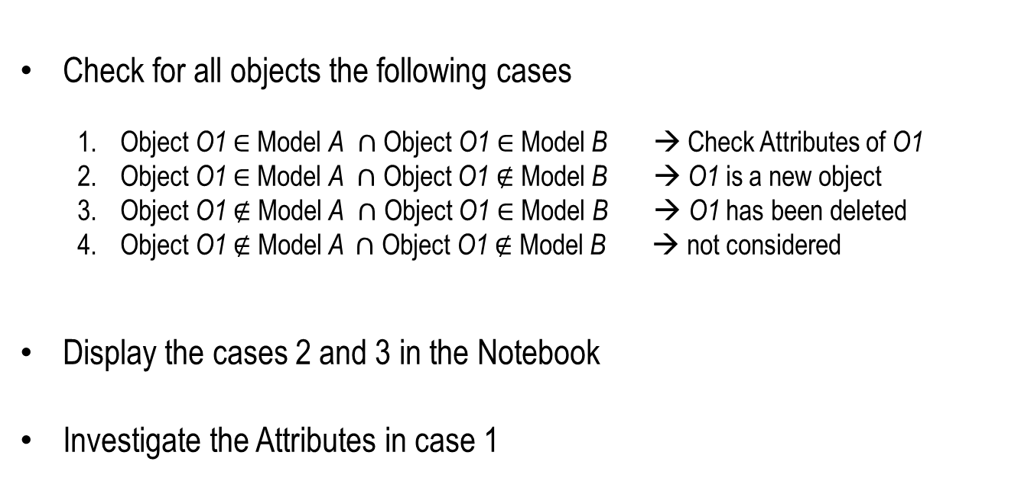
Model Parsing: Object Level
Check for all objects the following cases
  Object O1 $∈$Model A $∩$ Object O1 $∈$Model B → Check Attributes of O1
  Object O1 $∈$Model A $∩$ Object O1 ∉ Model B → O1 is a new object
  Object O1 ∉ Model A $∩$ Object O1 $∈$Model B → O1 has been deleted
  Object O1 ∉ Model A $∩$ Object O1 ∉ Model B → not considered
Display the cases 2 and 3 in the Notebook
Investigate the Attributes in case 1

Slide 18
Model Parsing: Object Level
Check for all objects the following cases
  Object O1 $∈$Model A $∩$ Object O1 $∈$Model B → Check Attributes of O1
  Object O1 $∈$Model A $∩$ Object O1 ∉ Model B → O1 is a new object
  Object O1 ∉ Model A $∩$ Object O1 $∈$Model B → O1 has been deleted
  Object O1 ∉ Model A $∩$ Object O1 ∉ Model B → not considered
Display the cases 2 and 3 in the Notebook
Investigate the Attributes in case 1

Slide 19
Model Parsing: Attribute Exceptions
Before we analyze all attributes the hidden attribute “Position” has to take out first . The reason for this purpose is that the position attribute consists of four units.
  “x” defines the x-coordinate of the object
  “y” defines the y-coordinate of the object
  “w” defines the width of the object
  “h” defines the height of the object
So we have to parse it into its units to compare.
LEO parse: (“Position_Val”) get-tmm-value:n_x_val:"x"
get-tmm-value:n_y_val:"y"
get-tmm-value:n_w_val:"w"
get-tmm-value:n_h_val:"h"

Slide 20
Model Parsing: Attribute Exceptions
The other attributes are of different kinds of attribute types and need to be handled in six different ways.
 | Str-exception | Expr-exception | Int-exception | Inter-exception | Tab-exception | Time-exception
Date | x
Datetime | x
Enumeration | x
Enumerationlist | x
Expression |  | x
Floating Number |  |  | x
Integer |  |  | x
InterRef |  |  |  | x
Longstring | x
Programcall
String | x
Table |  |  |  |  | x
Time |  |  |  |  |  | x

Slide 21
Model Parsing: Attribute Exceptions
Position
  “Position”-Attribute
  IF (s_AttrName = "Position") {
  CC "Core" GET_ATTR_VAL objid:(n_Newobjid) attrid:(VAL atid)
  SET val_AttrVal:(val)
  LEO parse: (val_AttrVal) get-tmm-value:n_x_val:"x" get-tmm-value:n_y_val:"y"
  CC "Core" GET_ATTR_VAL objid:(n_OldObjId) attrid:(VAL atid)
  SETG val_OldAttrVal: (val)
  LEO parse: (val_OldAttrVal) get-tmm-value:n_x_oldval:"x" get-tmm-value:n_y_oldval:"y"
  IF (n_x_oldval = n_x_val) {
  IF (n_y_oldval = n_y_val) { #do nothing
  }
  }
  ELSE {
  PROCEDURE SAVE_IN_RECORD
  }
  }
# Select the attribute “Position”
# Get the attribute value of “Postion” and
# save it under a variable (val_Attr_Val)
# Parse “Position” into its units
# Get the “Position” value of the second model
# save it under a variable (val_OldAttrVal)
# Parse “Position” into its units
# If the position didn’t change → do nothing

Slide 22
Model Parsing: Attribute Exceptions
Str-exception Attributes:
  # Get the attribute value of the corresponding attribute in model A
  CC "Core" GET_ATTR_VAL objid:(n_Newobjid) attrname:(s_AttrName)
  # Assign the output to a variable
  SETG val_AttrVal: (val)
  # Define an AQL expression with the object_name, class_name, attribute_name, and attribute_value
  SET aqlgetAttrOldModel: ("({\"" + s_Newobjname + "\":\"" + id_NewClassName + "\"}[?\"" + s_AttrName + "\" = \"" + val_AttrVal + "\"]
  # Evaluate the query in the second model
  CC "AQL" EVAL_AQL_EXPRESSION expr: (aqlgetAttrOldModel) modelid:(id_OldModelId)
  # Assign the output to variable
  SET s_ComparisonObj: ( objids )
  # If there is no matching to the query then get corresponding attribute value of the model B
  IF ( s_ComparisonObj = "") { CC "Core" GET_ATTR_VAL objid:(n_OldObjId) attrname:(s_AttrName)
  SETG val_OldAttrVal:(val)
  }
Str-exception

Slide 23
Model Parsing: Attribute Exceptions
Int-exception
Int-exception Attributes
  # Get the attribute value of the corresponding attribute in model A
  CC "Core" GET_ATTR_VAL objid:(n_Newobjid) attrname:(s_AttrName)
  # Assign the output to a variable
  SETG val_AttrVal: (val)
  # Save the value as string
  SETG s_AttrVal: (STR (val_AttrVal))
  # Define an AQL expression with the object_name, class_name, attribute_name, and attribute_value
  SETG aqlgetAttrOldModel: ("{\"" + s_Newobjname + "\":\"" + id_NewClassName + "\"}[?\"" + s_AttrName + "\" =" + s_AttrVal + "]") # Evaluate the query in the second model
  CC "AQL" EVAL_AQL_EXPRESSION expr: (aqlgetAttrOldModel) modelid:(id_OldModelId)
  # Assign the output to a variable
  SETG s_ComparisonObj: ( objids )
  # If there is no matching to the query then get corresponding attribute value of the model B
  IF ( s_ComparisonObj = "") {
  CC "Core" GET_ATTR_VAL objid:(n_OldObjId) attrname:(s_AttrName)
  SETG val_OldAttrVal:(val)
  }

Slide 24
Model Parsing: Attribute Exceptions
Inter-exception
Inter-exception Attributes
  # Get the attribute value of the corresponding attribute model A
  CC "Core" GET_ATTR_VAL objid:(n_Newobjid) attrid:(VAL atid)
  # Assign the output to a variable
  SETG val_AttrVal: (val) # Get the attribute value of the attribute in model B
  CC "Core" GET_ATTR_VAL objid:(n_OldObjId) attrid:(VAL atid)
  # Assign the output to a variable
  SETG val_OldAttrVal: (val)
  # If there is no matching to the query then get corresponding attribute value of the model B
  IF (val_OldAttrVal != val_AttrVal) { CC "Core" GET_ATTR_VAL objid:(n_OldObjId) attrname:(s_AttrName)
  SETG val_OldAttrVal:(val)
  }

Slide 25
Model Parsing: Attribute Exceptions
Tab-exception
Tab-exception Attributes
In Work: With FOR-strings

Slide 26
Model Parsing: Attribute Exceptions
Time-exception
Time-exception Attributes
  # Get the attribute value of the corresponding attribute model A
  CC "Core" GET_ATTR_VAL objid:(n_Newobjid) attrname:(s_AttrName)
  # Assign the output to a variable
  SETG val_AttrVal: (val)
  # save the value as string
  SETG s_AttrVal: (STR (val_AttrVal))
  # Define an AQL expression with the object_name, class_name, attribute_name, and attribute_value
  SETG aqlgetAttrOldModel: ("({\"" + s_Newobjname + "\":\"" + id_NewClassName + "\"}[?\"" + s_AttrName + "\" = \"" + s_AttrVal + "\"])") # Evaluate the query in the second model
  CC "AQL" EVAL_AQL_EXPRESSION expr: (aqlgetAttrOldModel) modelid:(id_OldModelId)
  # Assign the output to a variable
  SETG s_ComparisonObj: ( objids )
  # If there is no matching to the query then get corresponding attribute value of the model B
  IF ( s_ComparisonObj = "") {
  CC "Core" GET_ATTR_VAL objid:(n_OldObjId) attrname:(s_AttrName)
  # Assign the output to a variable
  SETG val_OldAttrVal:(val)
  }

Slide 27
Visualization of the Results
There are several ways to display results with ADOxx.
Display in the notebook (model, object)
  In a record table
Save in an extern file (e.g. .xls)
Display with another model
(see: http://www.adoxx.org/live/faq/-/message_boards/message/173234)

Slide 28
Handling Track Changes
GraphRep notification
  Notify the objects with an additional sign on their graphs that shows that there have been modifications of the attributes.
Track change accepting
  Individual
    The ability to accept every single track change using event listener in ADOxx.
  All
    Accept all changes by one click.

Slide 29
Added Value of Metamodelling Platform
Used meta-modelling functionality for realisation of the scenario:
ADOscript:
  Iterative breadth-first tree traversal
  AdoScript can save the results of the comparison of two models in the “ModelAttrRep” as rows.
AQL: ADOxx Query Language
  ADOxx query engine is provided by the platform and can analyze business process models.
  ADOScripts can invoke the query engine and hence compare in a stepwise approach business processes
Event Handler: The results can be accepted or not. This decisions are listened with the event handler “AfterEditAttributeValue” to manipulate the saved output in the “ModelAttrRep”.

Slide 30
ADOxx Realisation Hands-On
Modelling Language Extensions to enable this algorithms
  Create new meta class: “__ModelTypeMetaData__” and assign the created attribute “ModelAttrRep” as
  the AttrRep of the modeltype.
  Add record tables of the result-display into “ModelAttrRep”
  Create notification in the GraphRep
Configure ADOxx
  Configure Menubar
  Write AQL statements for query engine
Implement Algorithm with AdoScript
  ADOscript User Interface
  Invoking query engine with ADOscript
  Save results in record tables

Slide 31

Used ADOxx Functionality: Implementing an Algorithm
Introduction
Setup of Implementation Environment
Mechanisms & Algorithms Implementation
 | Core Functions for Model Manipulation
 |  | Database
 |  | Visualisation
 |  | Query
 |  | Transformation
 | Configuration of ADOxx Components
 |  | Visualisation
 |  | Query
 | External Coupling ADOxx Functionality
 |  | ADOscript Triggers
 |  | ADOscript Language Constructs
 |  | Visualisation ADOscript
 |  | Visualisation Expression
 |  | Query ADOscript
 |  | Transformation ADOscript
 | ADD-ON Implementation
 |  | ADOxx Web-Service
 |  | XML / ADL Import – Export
 |  | ADOscriptBatch Mode
Modelling Language Implementation
 | Classes
 | Relations
 | Class Attributes and Attributes
 |  | GRAPHREP
 |  | ATTRREP
 |  | CLASS Cardinality
 |  | CONVERSION
 |  | Model Pointer
 | Attribute Facets
 | Model Types

Slide 32
SCENARIO:
Implementing an Algorithm
HANDS-ON
Parsing and Comparing Models with AdoScript

Slide 33
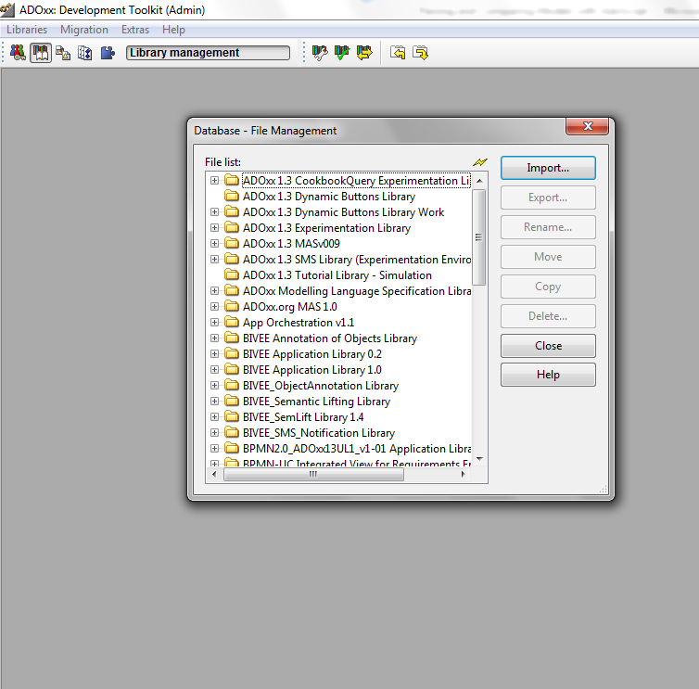
Import AdoScript File
Import Files
Select “Extras” in the Development Toolkit Menu.
Go to “File Management”
Import “CompareModels.asc” and “AcceptChange.asc”

Slide 34
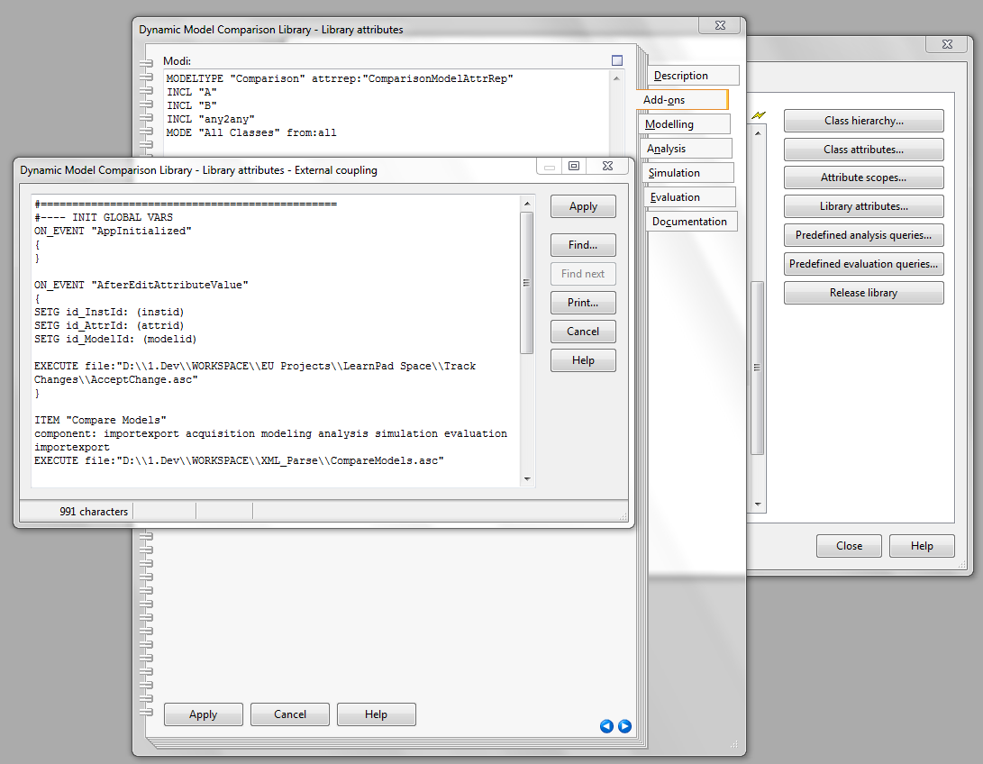
Define New Menu Item
Define Menu Item
Open Library attributes
Select Add-ons
Go to external Coupling
Define menu item:
ITEM "Compare Models"
component: importexport acquisition modeling analysis simulation evaluation importexport
EXECUTE file:(db:\\Comparemodels.asc)

Slide 35
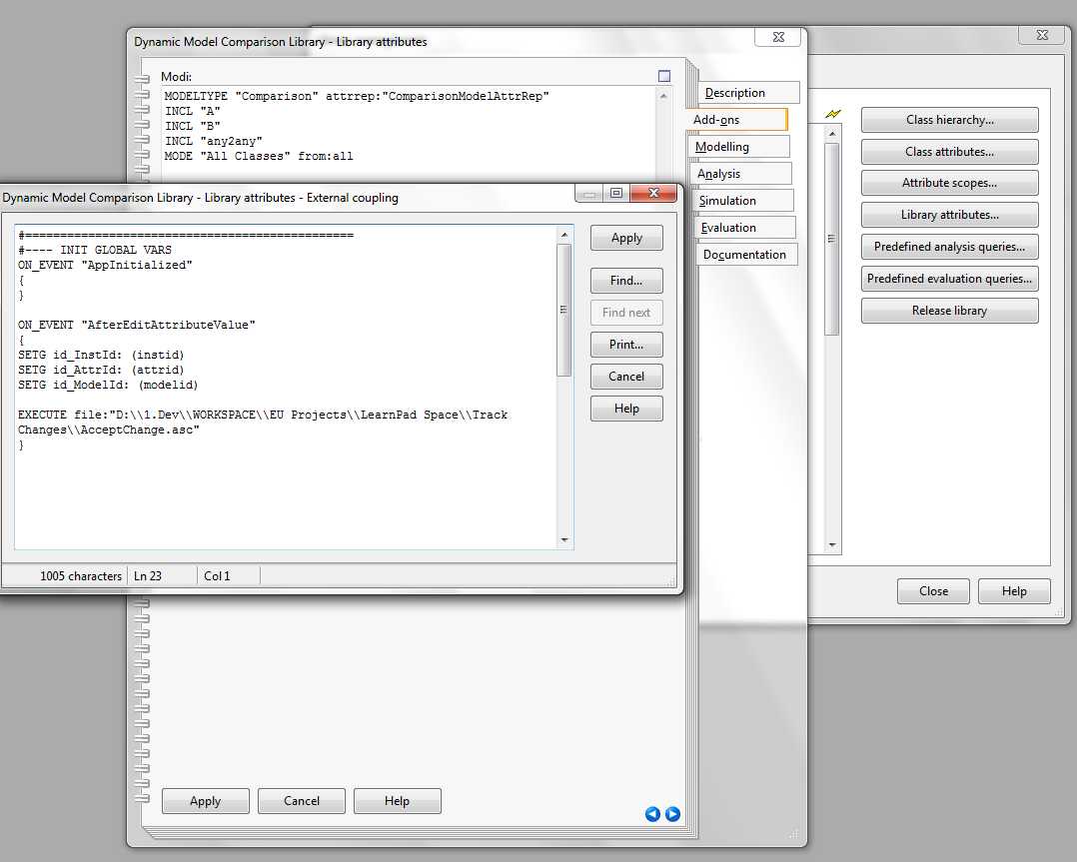
Define Event Handler
Define Menu Item
Open Library attributes
Select Add-ons
Go to external Coupling
Define
ON_EVENT “AfterEditAttributeValue”
{
SETG id_InstId: (instid)
SETG id_AttrId: (attrid)
SETG id_ModelId: (modelid)
EXECUTE file”db:\\AcceptChange.asc"
}

Slide 36
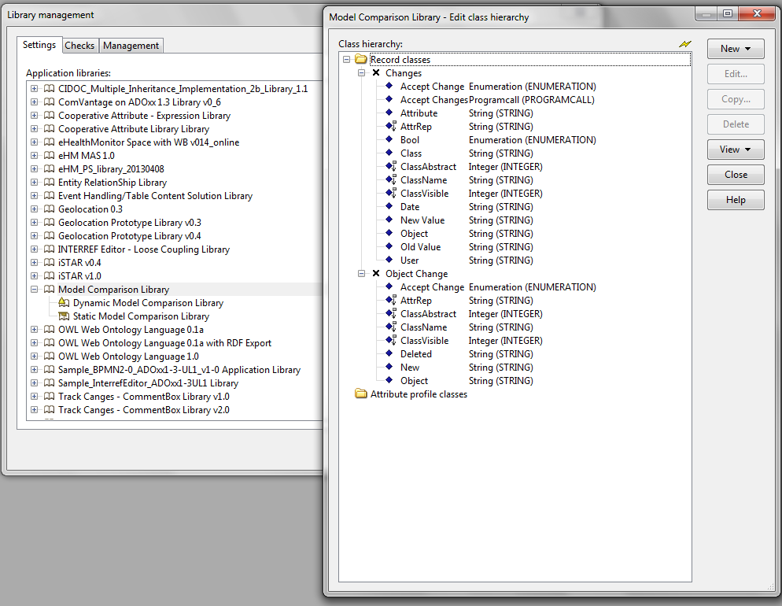
Define Record Classes
Define Record Classes:
Select the Library that you want to integrate the algorithm
Create New Record Class:
  “Changes” with Attributes:
    Accept Change (ENUMERATION)
      No
      Yes
    Attribute
    New Value
    Object
    Old Value
  “Object Change” with Attributes:
    Accept Change
    Deleted
    New
    Object
Define AttrReps:
  For “Changes”
  NOTEBOOK
  CHAPTER "Description"
  ATTR "Object"
  ATTR "Attribute"
  ATTR "New Value" width:24
  ATTR "Old Value"
  ATTR "Accept Change"
  For “Object Change”
  NOTEBOOK
  CHAPTER "Description"
  ATTR "Object"
  ATTR "New"
  ATTR "Deleted"
  ATTR "Accept Change"

Slide 37
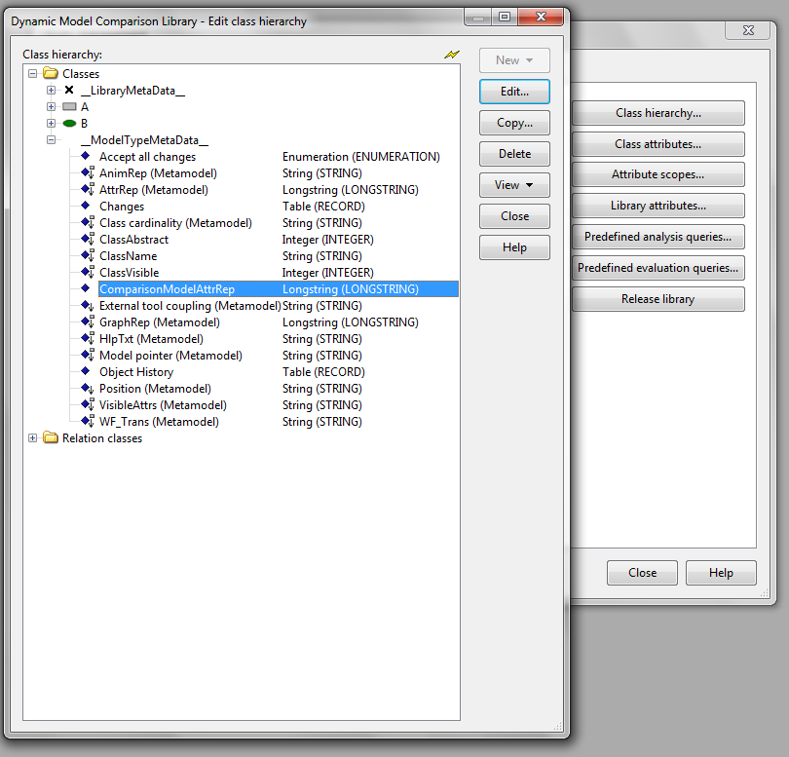
Model Type Meta Data
Define __ModelTypeMetaData__
Create a meta class “__ModelTypeMetaData__”
Create attributes:
  Changes (RECORD [Changes])
  Accept all changes (ENUMERATION)
  Object History (RECORD [Object Change])
  ComparisonModelAttrRep (LONGSTRING)
  NOTEBOOK
  CHAPTER "Object Changes"
  ATTR "Object History"
  CHAPTER "Track Changes"
  ATTR "Changes" lines:15
  GROUP "Accept all changes"
  ATTR "Accept all changes"

Slide 38
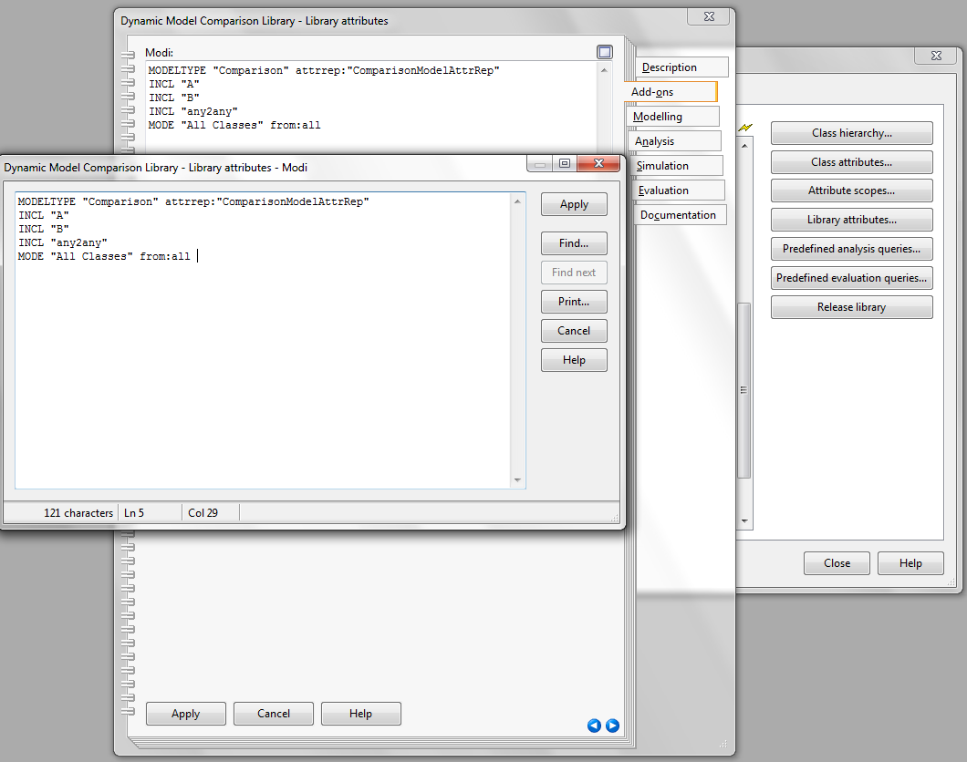
Define Model Type AttrRep
Define Model Type AttrRep
Open Library attributes
Select Add-ons
Go to Modi:
Assign new AttrRep for the ModelType
MODELTYPE "Comparison" attrrep:"ComparisonModelAttrRep"

Slide 39
Parse and Compare Models: Code
#--------------------------------------------------------------------------------
#------------------Select The Model which should be parsed--------
#--------------------------------------------------------------------------------
CC "CoreUI" MODEL_SELECT_BOX title:"Select Modified Model"
# --> RESULT endbutton:strValue [ modelids:idList | threadids:idList ]
#[ mgroupids:idList ] [ appmodelids:idList ] [ extraValues ]
SETG id_NewModelId:(VAL modelids)
SETG str_endbutton:(endbutton)
#--------------------------------------------------------------------------------
#------------------------Select The Model to compare with-------------
#--------------------------------------------------------------------------------
CC "CoreUI" MODEL_SELECT_BOX title:"Select Original Model"
# --> RESULT endbutton:strValue [ modelids:idList | threadids:idList ]
#[ mgroupids:idList ] [ appmodelids:idList ] [ extraValues ]
SETG id_OldModelId:(VAL modelids)
SETG str_endbutton:(endbutton)
IF (id_NewModelId = id_OldModelId) {
CC "AdoScript" ERRORBOX "The Models are identical. \n Please Select two different Models!"
EXIT
}
#-----------------------Cancel Button----------------------
IF (str_endbutton = "cancel")
{ # user pressed cancel-button
EXIT
}
#--------------------------------------------------------------------------------
#----------------GET ALL VISIBLE CLASSES IN THE MODEL-
#--------------------------------------------------------------------------------
CC "Modeling" GET_VISIBLE_CLASSES modelid:(id_NewModelId)
# --> RESULT ecode:intValue classids:strValue
SETG n_ClassIds:(classids)
…

Slide 40
Accept Changes Event Handler: Code
#------------------------------------------------------------------
#-----------ON_EVENT "AfterEditAttributeValue"--------
#------------------------------------------------------------------
CC "Core" GET_ATTR_ID classid:(id_ModelId) attrname:"Changes"
SET id_RecAttrId:(attrid)
IF (id_AttrId = id_RecAttrId) {
CC "Core" GET_REC_ATTR_ROW_COUNT objid:(id_ModelId) attrid:(id_AttrId)
SETL n_rec_row_count:(count)
IF (n_rec_row_count > 1) {
FOR i from:(n_rec_row_count) to:(1) by:(-1)
{
CC "Core" GET_REC_ATTR_ROW_ID objid:(id_ModelId) attrid:(id_AttrId) index:(i)
#--> RESULT ecode: intValue rowid: id .
SETG id_RowId:(rowid)
CC "Core" GET_ATTR_VAL objid:(id_RowId) attrname:"Accept Change"
SET s_AcceptChangeBoolVal:(val)
IF (s_AcceptChangeBoolVal = "Yes") {
CC "Core" GET_ATTR_VAL objid:(id_RowId) attrname:"Class"
SET id_Classid:(VAL val)
CC "Core" GET_ATTR_VAL objid:(id_RowId) attrname:"Object"
SET n_ObjName:(val)
CC "Core" GET_ATTR_ID classid: (id_Classid) attrname:("ChangeGraph")
CC "Core" GET_OBJ_ID modelid:(id_ModelId) classid:(id_Classid) objname:(n_ObjName)
SET n_ObjId:(objid)
CC "Core" GET_ATTR_VAL objid: (n_ObjId) attrname:"ChangeGraph"
…

Slide 41
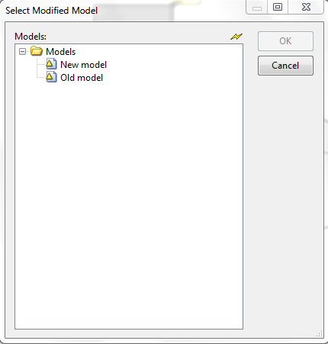
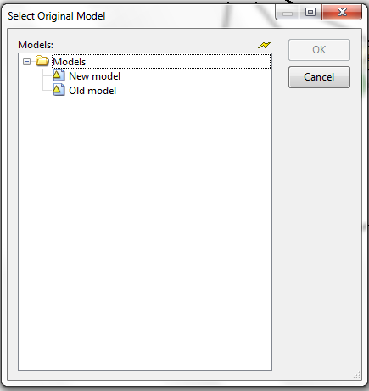
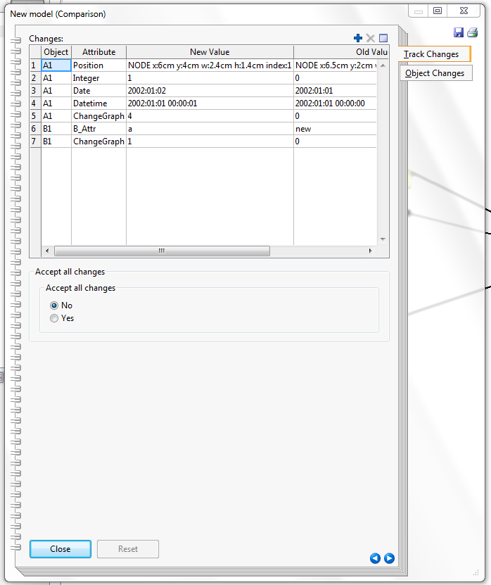
Result:
2
Go to “Tools” → “Compare Models”
Select Modified Model
Select Original Model
Open Model Notebook
3
4

Slide 42


Further Questions?
www.adoxx.org
tutorial@adoxx.org
Notes:
42

